Slide 1

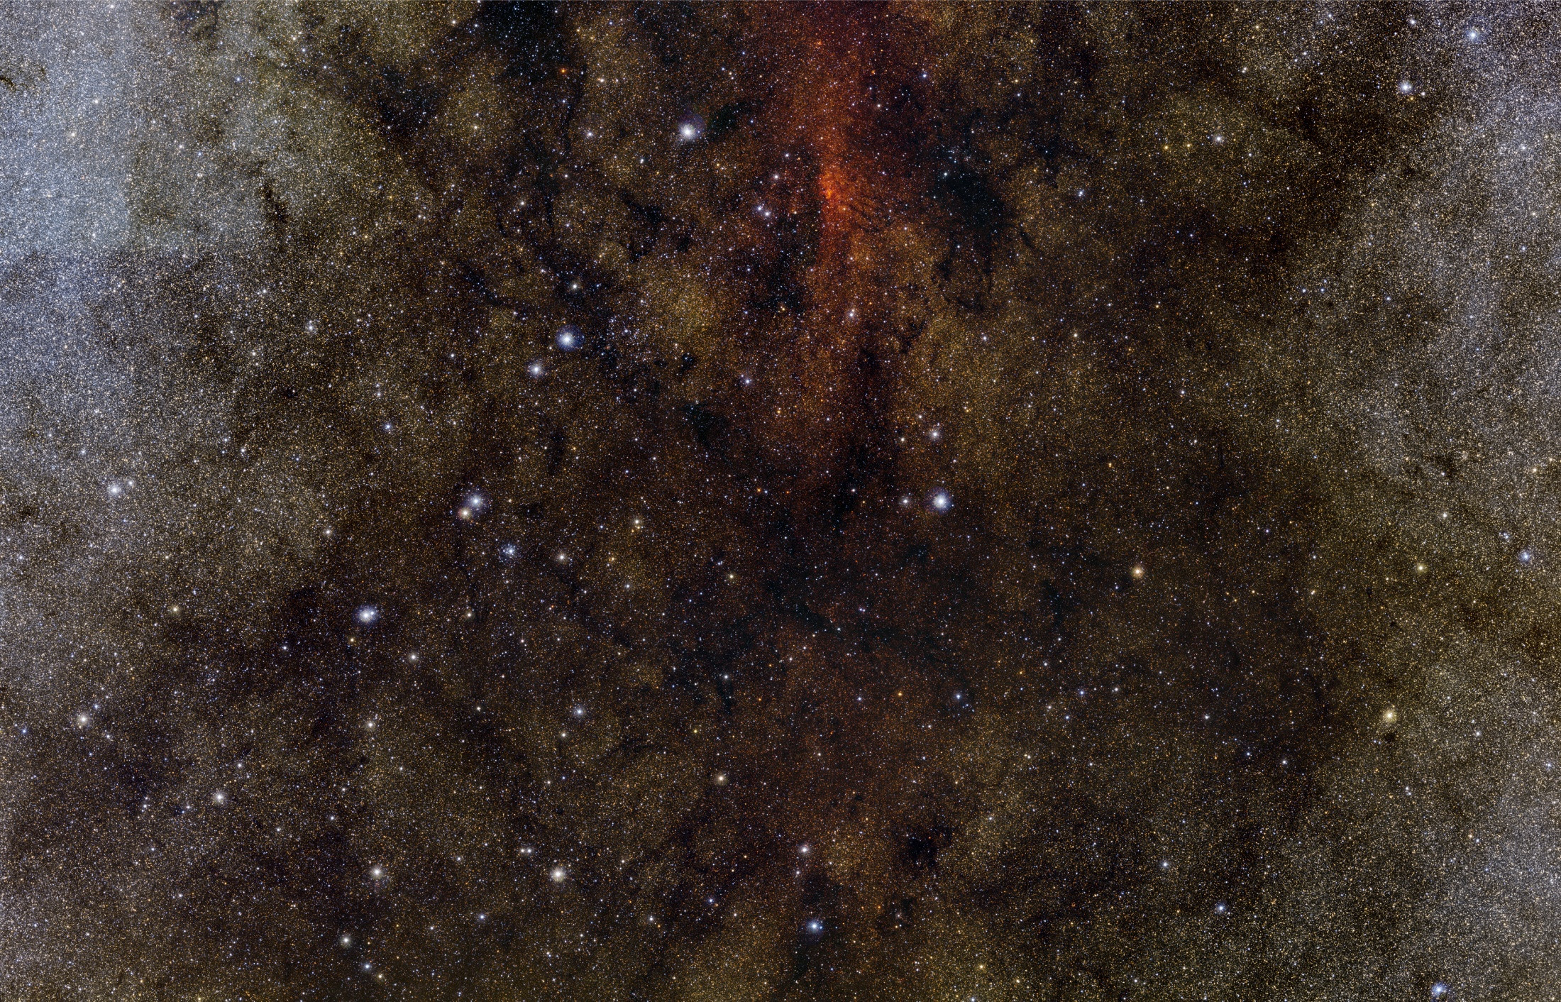
First Public Data Releases from the VISTA Science Archive
Nicholas Cross, Rob Blake, Ross Collins, Mark Holliman, Mike Read, Eckhard Sutorius, Nigel Hambly, Bob Mann, Keith Noddle
Wide Field Astronomy Unit, Institute for Astronomy, Edinburgh, UK

Slide 2
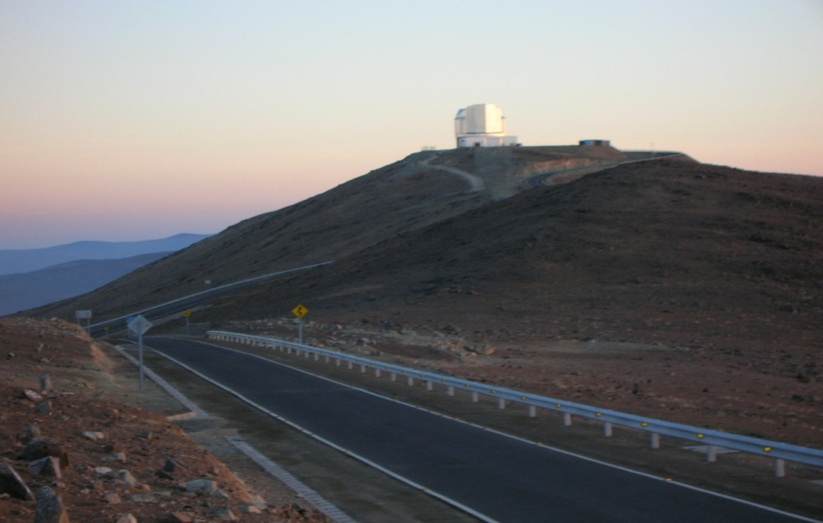
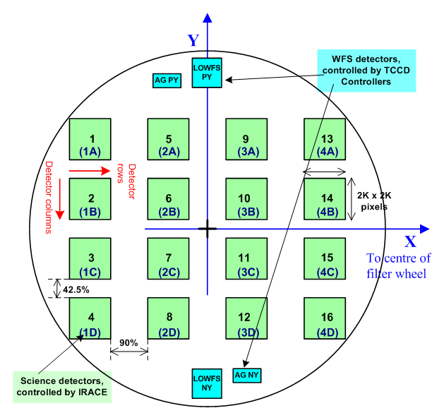
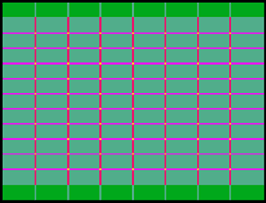
VISTA
4.1m NIR telescope at Cerro Paranel.
16 2k x 2k Raytheon VIRGO detectors
0.34” pixels
0.6 □° FOV
Standard frame is a tile, 1.5□° made of 6 pointings
~300GB of imaging data per night (~70% of Paranal data)

Slide 3
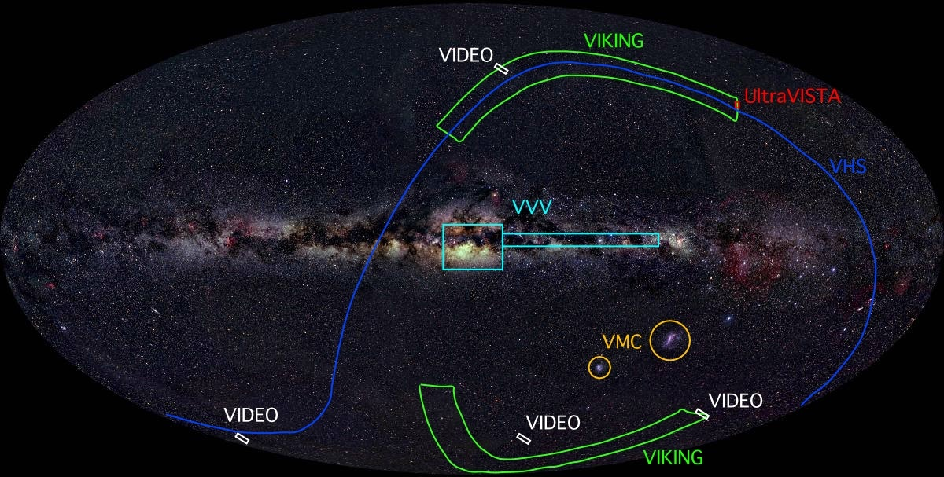
VISTA Public Surveys.

Slide 4
VISTA Public Surveys
3 extra-galactic in wedding cake arrangement to optimise depth/area for different redshifts:
  VIKING: ZYJHKs. Ks=19.3, 1500□°
  VIDEO: ZYJHKs. Ks=21.6, 12□°
  UltraVISTA: YJHKs+NB. Ks=23.7, 0.8□°
Variability survey of MW disk and bulge:
  VVV: ZYJHKs. Ks=18.1, 520□°, 100 epochs in Ks. (10⁹ sources 10¹⁰-10¹¹ detections) ~10⁶ sources / □°
Survey of Magellanic Clouds:
  VMC: YJKs. Ks=20.3, 184□°, 12 Ks epochs for Cepheid/ RR Lyrae constraints.
All sky survey
  VHS: JKs (+ some YH). Ks=18.1, 20000□°

Slide 5


VISTA Data Flow System
Processing and archiving of all WFCAM and most VISTA data
Observation block processing by CASU in Cambridge + calibration
Later processing and archiving by WFAU in Edinburgh.
VISTA Science Archive contains a relation database that stores different types of related data.
Interfaces to help users more easily access, use and evaluate the data.
VSA: http://surveys.roe.ac.uk/vsa

Slide 6
Data
Data from CASU transferred as FITS images and tables (catalogues extracted from science frames)
  Image headers and tables stored in database
  Links to images, but image pixel data stored as flat files.
Higher order products (multi-band, variability tables) generated and stored in database
Linking and curation tables generated and stored in database – database is self describing.

Slide 7
Quality Control
Science images undergo QC at Garching and CASU, which is stored in image metadata
Additional frame quality control done by survey teams on science frames and automatically at WFAU - deprecation codes are stored in VSA.
Catalogue flagging is done for bad pixels at CASU, other issues such as saturation, deblending, near edge, and a host of other issues recorded in post-processing error bit flag in VSA.

Slide 8
Higher Order Products
Deep images and catalogues from multiple epochs.
Source table: merged detections in multiple filters from deepest observations in each pointing, seamed across overlaps.
SynopticSource table: merged detections in multiple filters at each epoch.
Variability table: photometric statistics from all epochs.
X-matched neighbour tables to external catalogues, e.g. SDSS, 2MASS, WISE, Spitzer, XMM.
Links between tile and pawprint detections.
Provenance and quality control information.

Slide 9
Relational data model
Entity-relation model (ERM) shows how different types of data are related to each other.
Each entity (box) is a different data type (stored as a table in the database).
One-to-one, one-to many, constraint on one table…
Design shows how tables that are used with multiple epoch data are related.

Slide 10
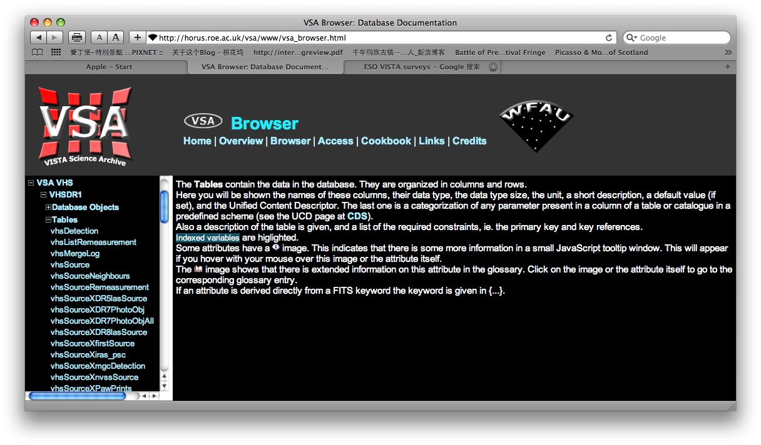
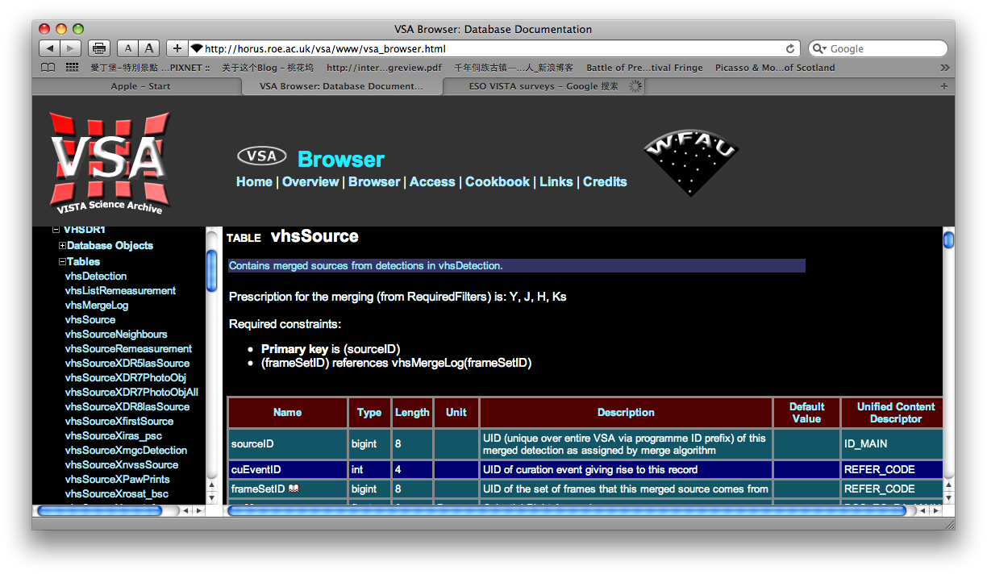
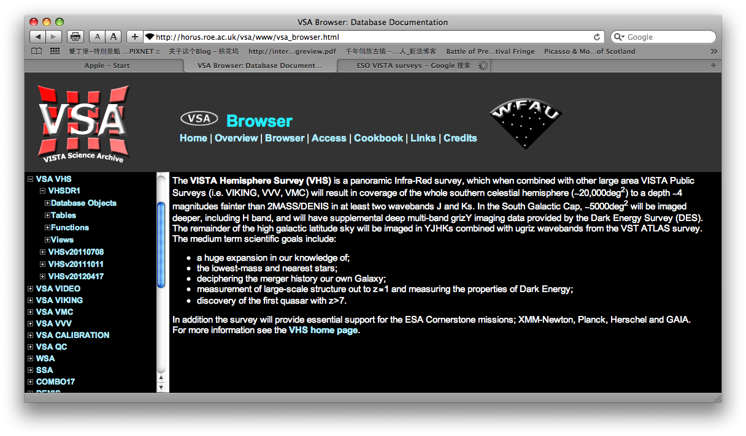
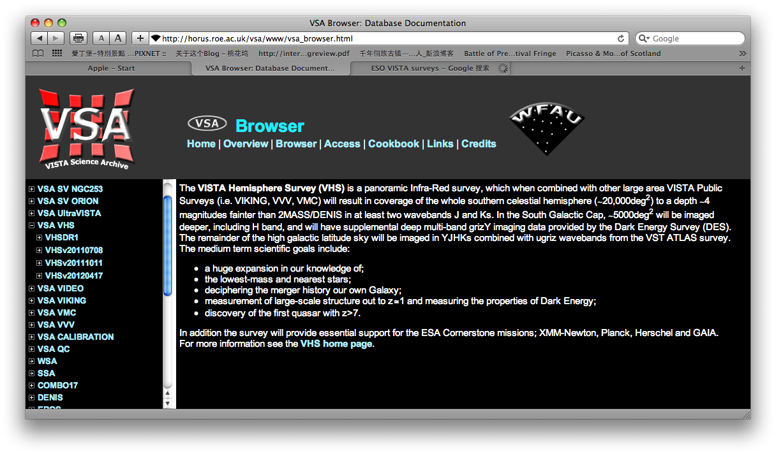
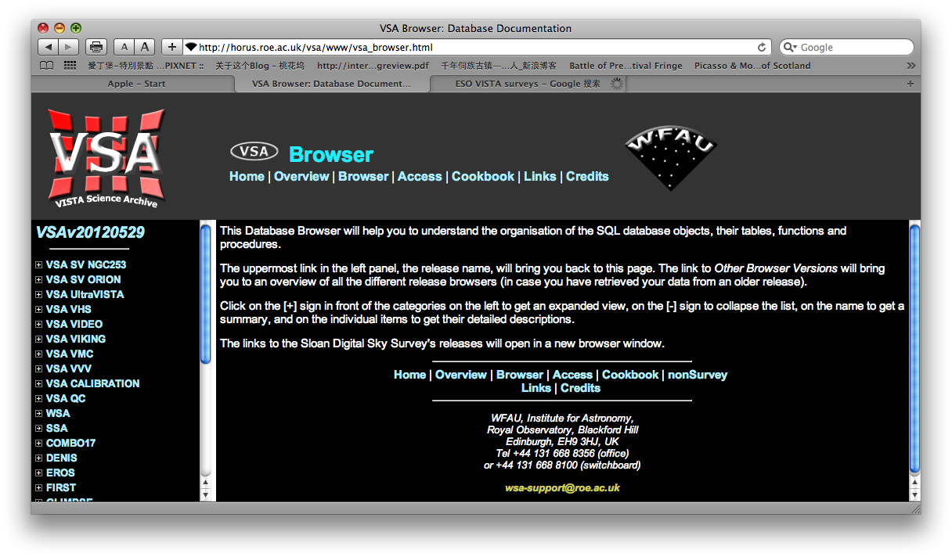
VSA – schema browser

Slide 11
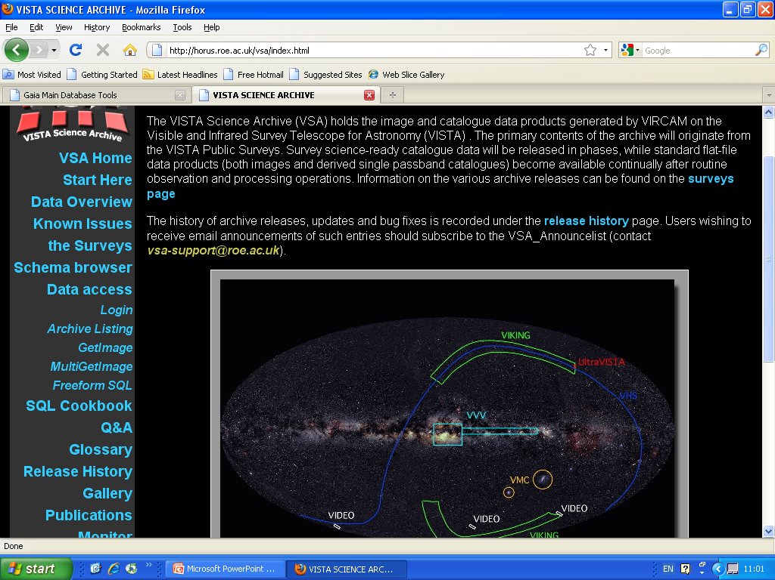
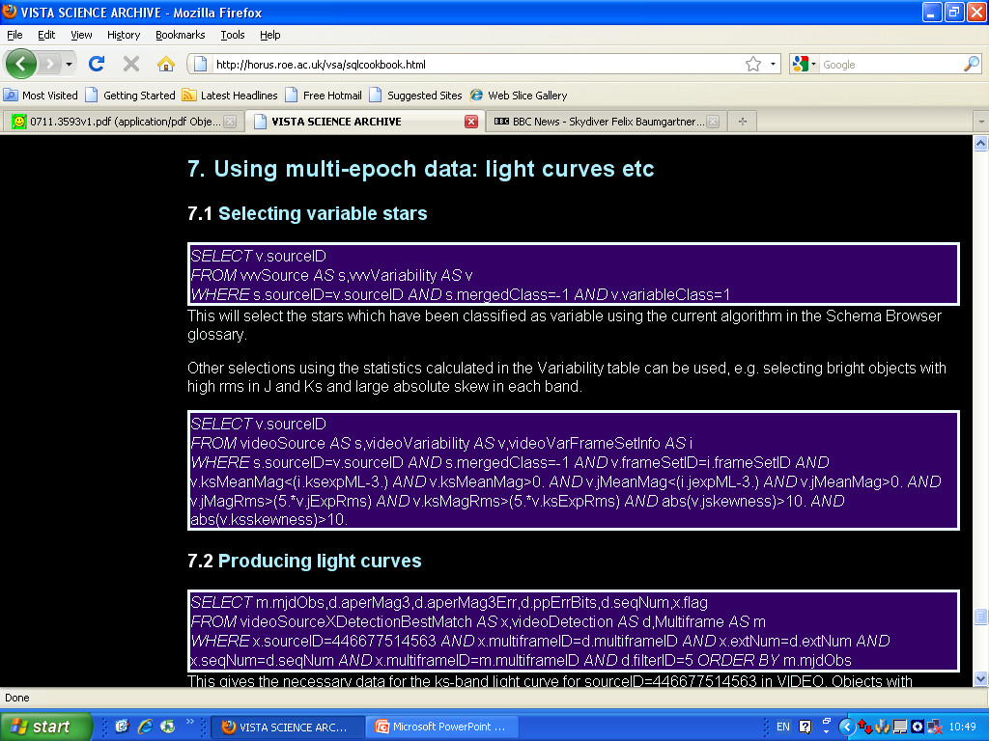

Slide 12
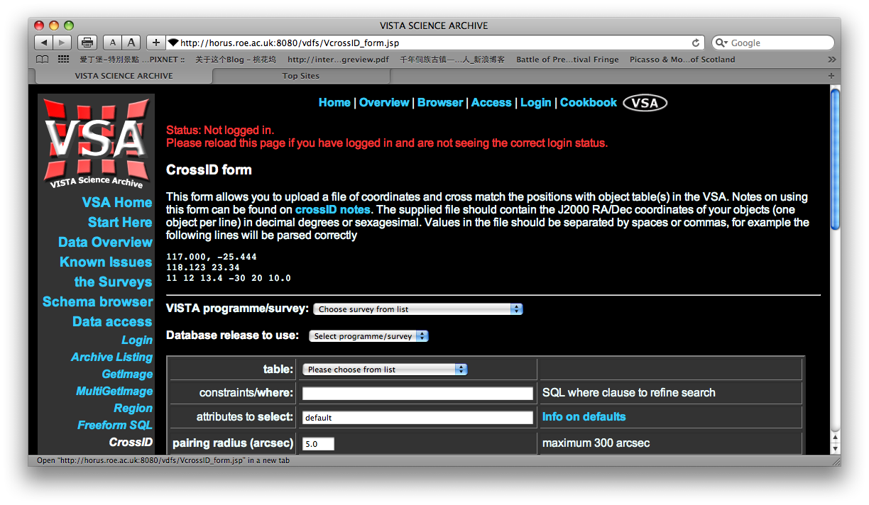
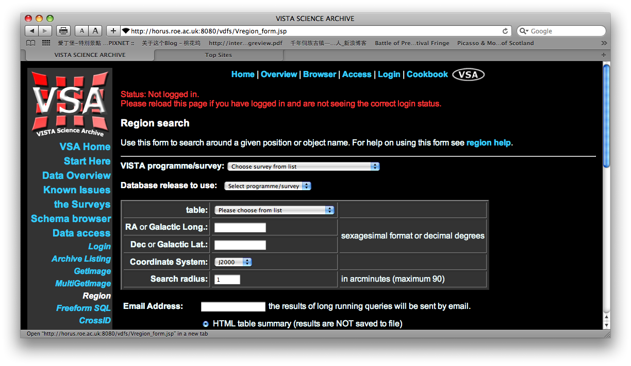
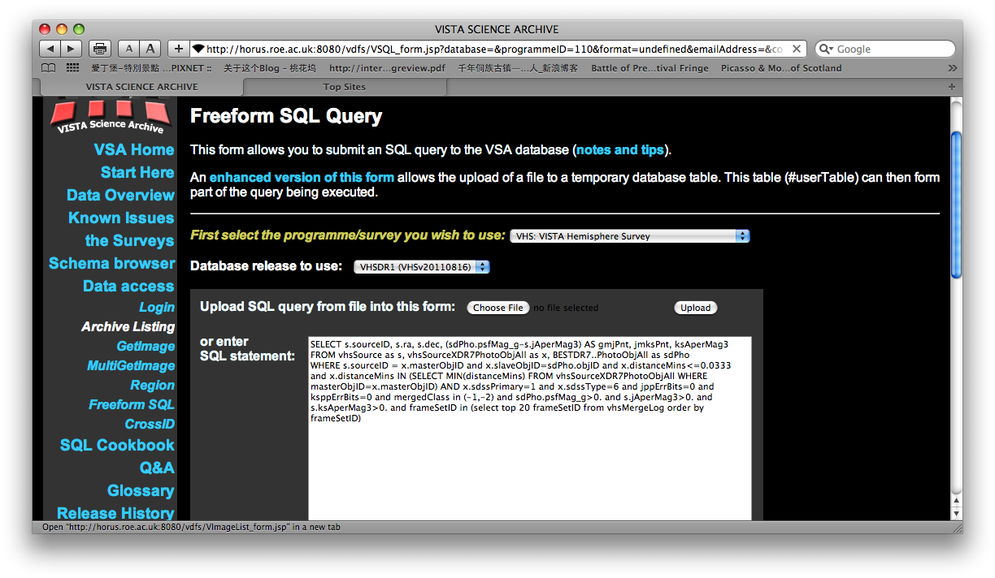
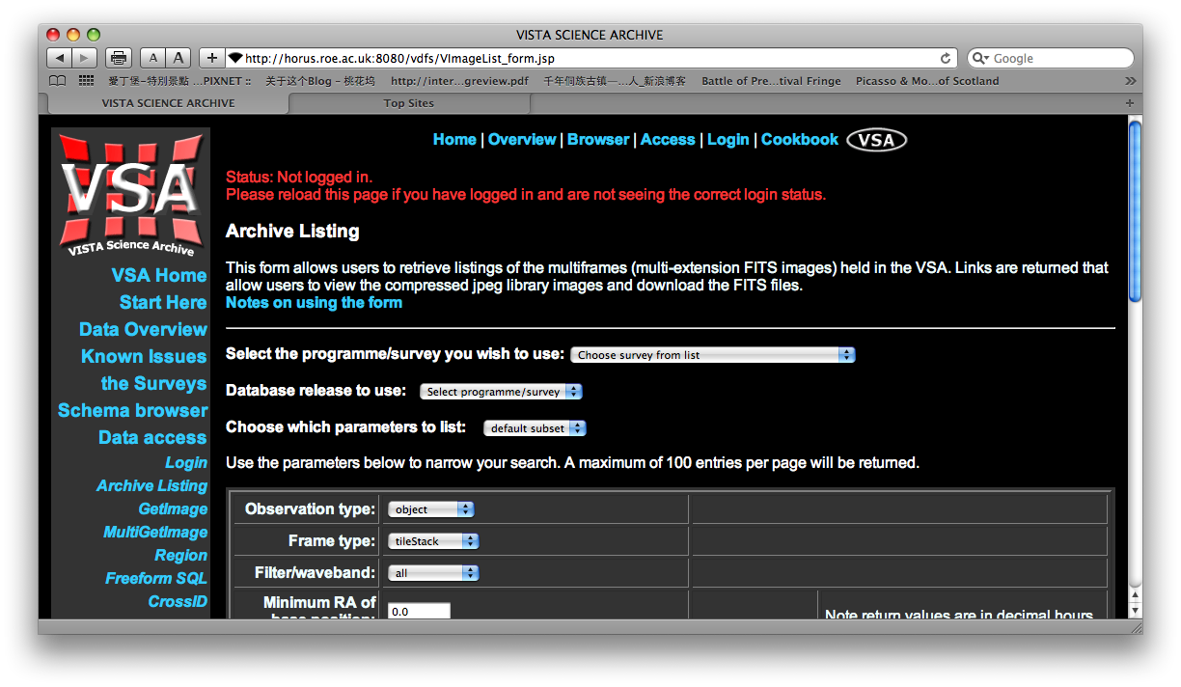
Interfaces

Slide 13
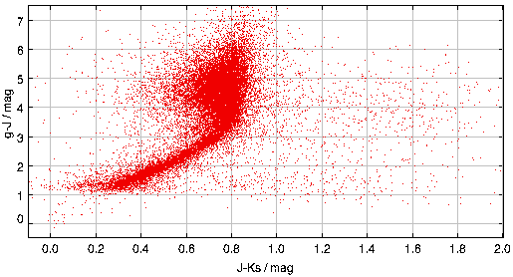
Scientific Queries
SELECT data in SQL, e.g. colour information from vhsSource and SDSS DR7 – matched through neighbour tables.
Can view query launch queries into TOPCAT, or download as FITS, VOTABLE or CSV.

Slide 14
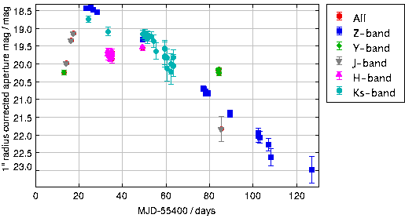
Light-curves
Z=0.06 SNe1a, SN2010gy,
Discovered in PanSTARRS,
Chornock et al. (2010)

Slide 15
1st public releases from VSA
Releases to the survey teams happen every 6 months. Releases to the public should happen on similar timescales from now on.
Any errors or potential problems that are found are mentioned in Known Issues. All releases are mentioned in the Release History.

Slide 16
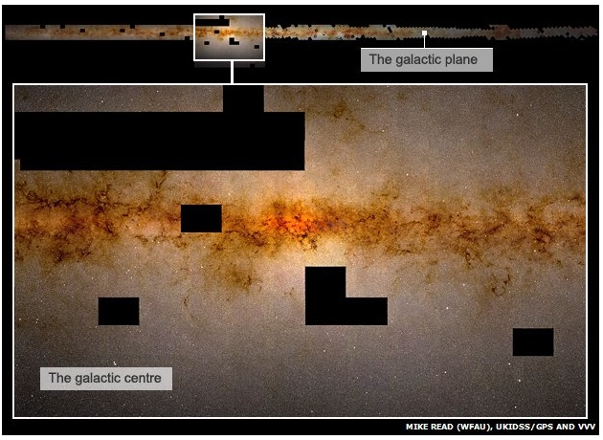
Large colour mosaics.
Allow scientists to pick out extended structures such as nebulae and clusters, which are difficult to find against a dense star field using automated software.
Zoomable, with coordinates.
1 billion stars in a single high resolution image.
http://djer.roe.ac.uk/vsa/vvv/iipmooviewer-2.0-beta/vvvgps5.html

Slide 17
Summary
For scientists to get the most out of large surveys, a well designed and easy to use database is essential.
The VSA allows scientists to build complex queries, accessing VISTA and other data
  Colour, variability, size, positional selections all very straightforward.
Most efficient way to discover rare objects in large surveys such as VVV.

Slide 18
Future work
Improved interfaces:
  MyDB like interface – programming environment
  Improved visualisation of large results (shading in dense regions, points in low-density regions).
  Improved SIAP and TOPCAT integration.
List-driven photometry (possibly PSF-corrected, but not initially).
  Initially internally within VIKING, eventually VHS + VST-ATLAS ++
Proper motion where applicable.
Bright star flagging.
Cross et al. 2012, A&A, submitted.

Slide 19
Long term difficulties.
VVV detection table – currently ~15 billion rows (tile and pawprint detections)
  Actually stored as a view ofmonthly tables to speed up ingestion and other curation.
  Most tasks on the VVV are I/O limited.
  Takes ~4-6 months to process 1 year. Some time can be saved, but some processing will get longer – not a simple matter of just adding in new data – variability statistics, copying out release DB

Slide 20
Solutions
Optimising SQL – query execution can be improved, but is a bit of a dark art. Not clear whether this will make substantial improvements any more.
Column orientated DB – beginning to experiment with this, but could require a lot of code rewriting.
Solid state devices for table storage. These are expensive, but are rapidly getting cheaper. May be the best solution in a few years time.

